Slide 1
Badger
Malia Villella

Slide 2
Introduction
At first I didn’t know anything about badgers but then I did research and found out a lot of things about badgers and it was fun! Here is what I found out. I hope you like it!

Slide 3
Habitat
Badgers are found living in the forest of Europe and Western Asia
The badger lives in underground burrows which often contains a maze of tunnels
The badger population is 300,000
Mixed woodlands
Pasture lands
Clearings
spinneys

Slide 4
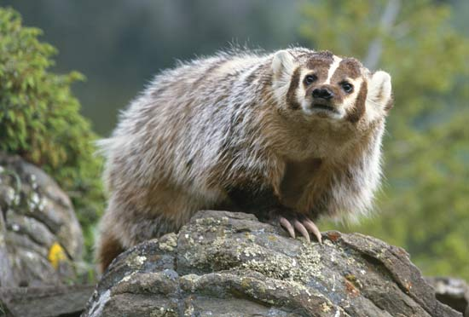
Characteristics
A Badger is capable of producing a painful bite and some Badgers are known to carry a type of rabies
The most commonly known Badgers are the white and black striped Badgers in Western Europe
A Badgers life span is 4-10 years
Long claws and a flatend body
The eyes are small and the ears are short and tipped with white
A honey badger has a white stripe down its back
Typical badgers have short legs and badgers also tend to be heavy built

Slide 5
Food
Worms
Berries
Root tubers
Cereals
Insects
Small mammals
carrion

Slide 6
Fun facts
Badgers are thought to be related to otters and weasels
The Asian stink badger was once classified as a badger but today this species badger species is thought to be more closely related to a skunk than a badger
The European badger is generally a peaceful animal having been known to share its burrow with other species such a rabbits, red foxes and raccoon dogs
Can run 30 km. an hour for a short per hour for short periods of time
Male badgers are called boars and female badgers are called sows
Old badgers sometimes have their hind claws almost completely worn away from constant use
Cubs are born pink with greyish silver fur and fused eyelids

Slide 7
Bibliography
Brittanica
Facts about badgers for kids
A-Z animals
Safe search.com

Slide 8




About the author
Malia loves to listen to music and dance and her favorite colors are torquise, green and purple her favorite TV channel is Disney she loves animals, books, arts and crafts, rainbows etc. she lives in Barrington R.I. with her fish, dog and family she is 9 years old

