Slide 1

Grey Dolphin
By Alexandra McKenzie

Slide 2
introduction
I love dolphins, but I don’t know much about them. So here are some facts about them! I learned so much about them I hope you do to! Enjoy!

Slide 3
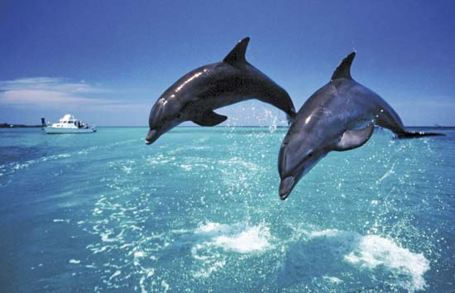
Habitat
Atlantic
Pacific
South east Indian ocean
Mediterranean sea
Harbors
Bays
Some in shallow water
Western Greece
Some deep water

Slide 4
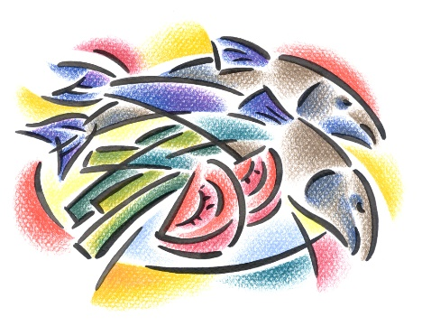
Food
Fish
Herring
Pilchard
Anchovies
Hake
Sardines
Bonito
Squid
Octopus
shrimp

Slide 5

Characteristics
Its weight is around 100kg and 300kg
There life span is 20-45 years!
They have awesome hearing
color: black, grey, and white
Black smiley face
White in the flower

Slide 6
Fun Facts
Travel groups up to 10-50
Speed up to 40kg
Nipping or bumping is a way of knowing there playing
There brain is half asleep
Bottlenose dolphin has a short nose so that makes them look like there smiling
At aquariums and zoos bottlenose dolphin’s perform

Slide 7
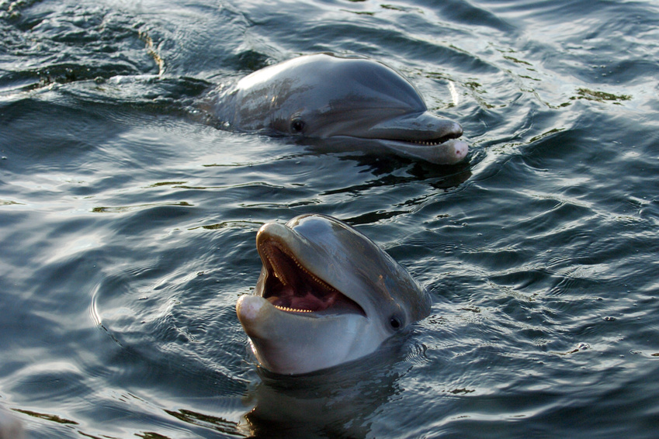
Fun facts
They can see for miles
They can only see a few feet under water
They talk by either squeak or whistle
Short beaked dolphins don’t have lips

Slide 8
Bibliography
Bibliography
Britannica
A-Z animals
Wikipedia
National Geographic
World book
Safe search

Slide 9

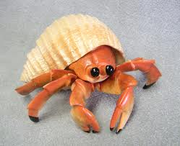
About The Author
name is Alexandra McKenzie, she is 9 years old. She loves to swim, draw, and play Minecraft. She also like animals like hermit crabs, fish, dogs, she has 3 dogs there names are Casey, Sophie, Harley. Her favorite color is torques. She also like to play flappy bird. She also loves to go horse back riding She also likes rock and pop music. She also loves hermit crabs!

