Slide 1
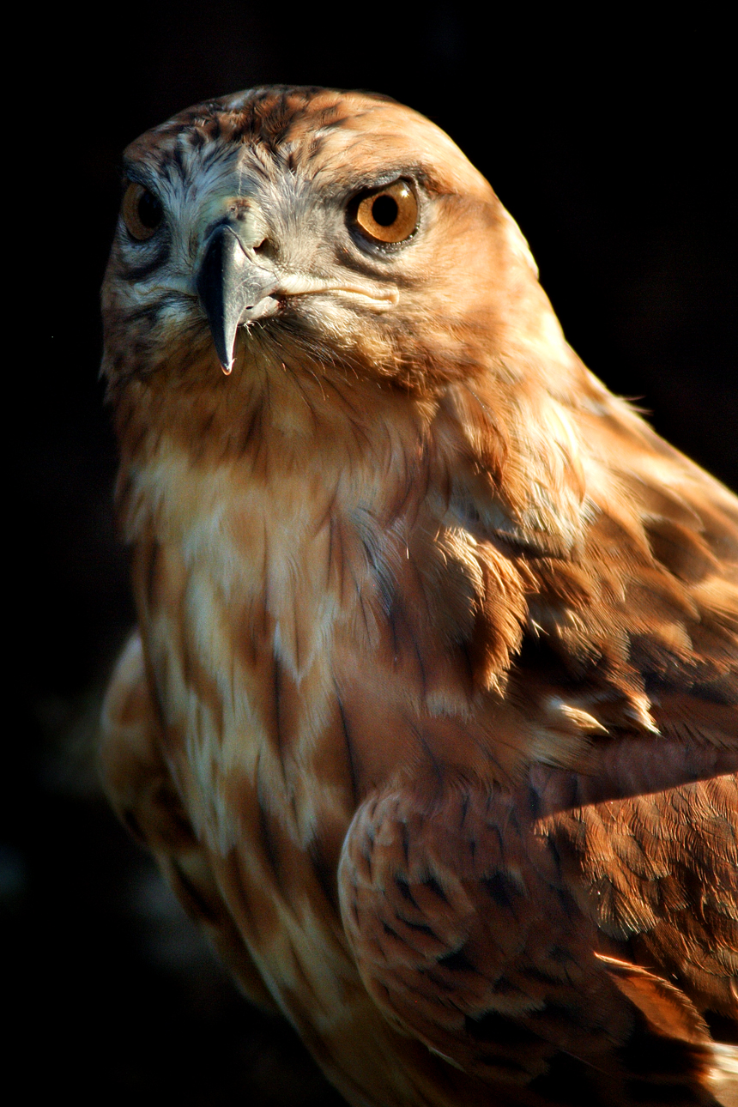
FALCON!
By Konstantinos Makris

Slide 2
introduction
. I picked the Falcon because I never new about Falcons and so they sounded really interesting I hope you enjoy my power point

Slide 3
Habitat
. Falcons live above ground they also sometimes Falcons live in trees and cliffs and mountains
.Falcon live

Slide 4
Characteristics
. Falcons have tampered wings
. There are more than 40 species
. They only come together in too mate
. 25cm tall to 60cm tall

Slide 5
Food
Falcons eat
Mice
Frogs
Fish
And catch small birds in the air

Slide 6
Fun Facts
. They are the fastest animals in the in the world when they dive
. Falcon have tapered wings
. There are more than 40 species of Falcons
. Falcons are medium sized birds
.Falcons predators are wolfs and people
. Falcons are adapted in many ways to maximize their chances of survival in the skies
. Falcons are birds of prey and are therefore known for their incredible hunting skills
. The young and inexperienced Falcons) in the air the eggs and chicks of the Falcon are particularly vulnerable to being eaten

Slide 7
Bibliography
. Google
. World book kids
. Britannica school
. Scratch . mitchedu

Slide 8
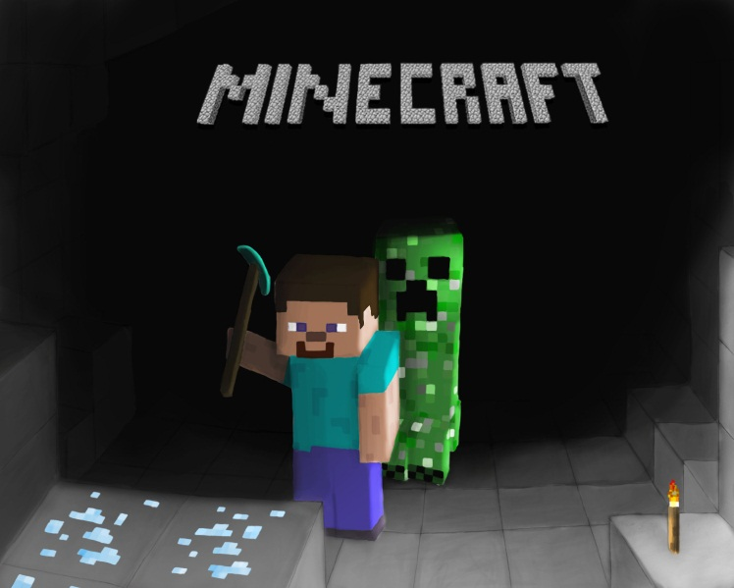
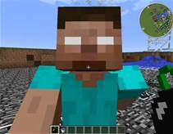
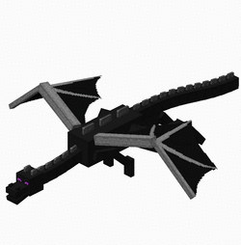
ABOUT THE Author!
I have a dog and I am 6 years old and I also play minecraft. A other fact about me is that also have a little brother he is 9 years old. He also like rock music!

