Slide 1

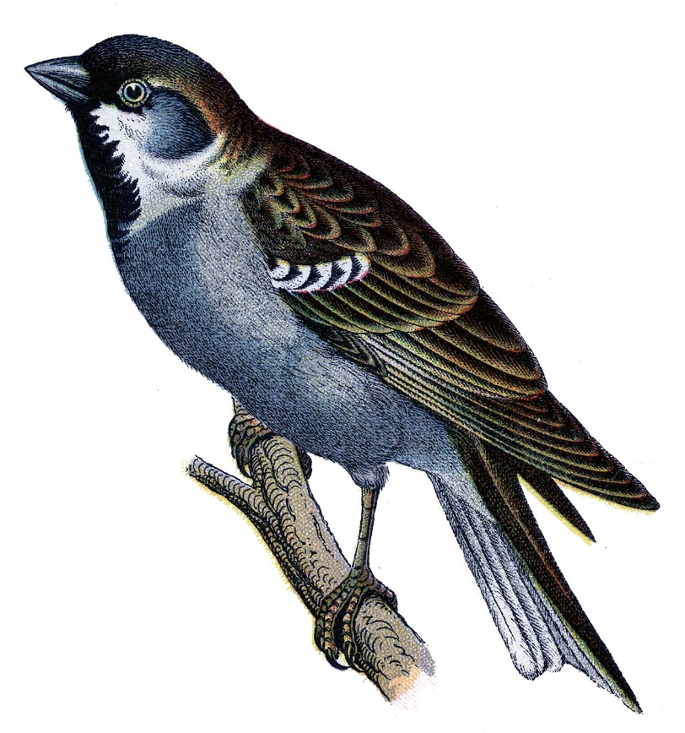
Falcon
Kyler Romano

Slide 2
Introduction
I researched falcons and it was a lot of fun learning about the falcon I have come to an end and I
Made this power point and I hope you enjoy.

Slide 3
Habitat
All continents not Antarctica
Prefer wide open spaces
Coasts
Found on bridges
Sky scrapers

Slide 4
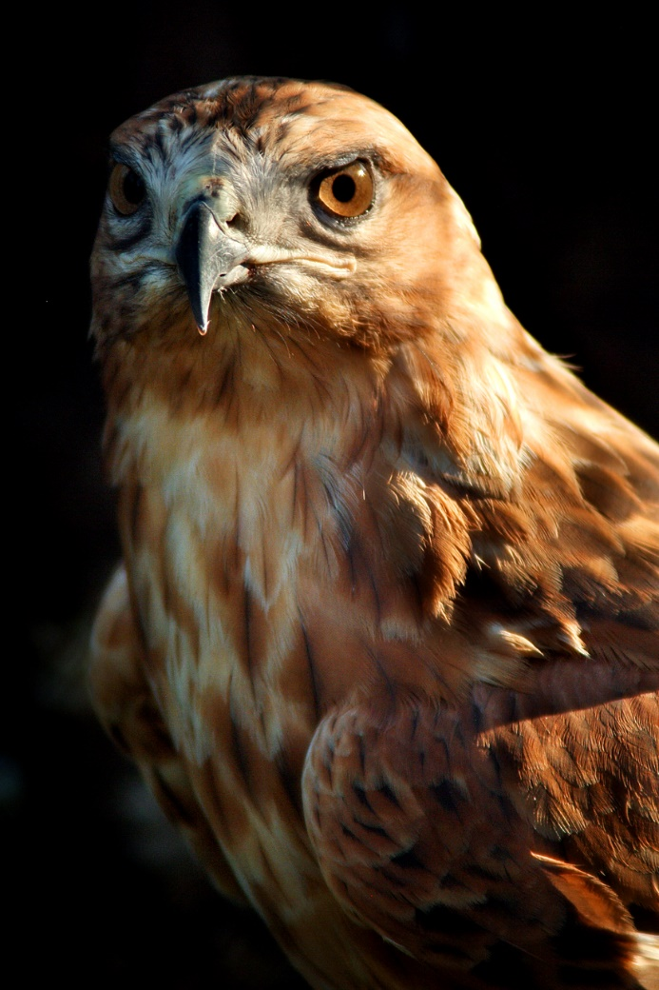
Characteristics
falcons have tapered wings
More then 40 different species
Only come together to mate
25cm tall to 60cm tall

Slide 5
Food
Prey on other birds and bats
Carnivore
Prey found all across world
Mice,frogs,fish,rabbits

Slide 6
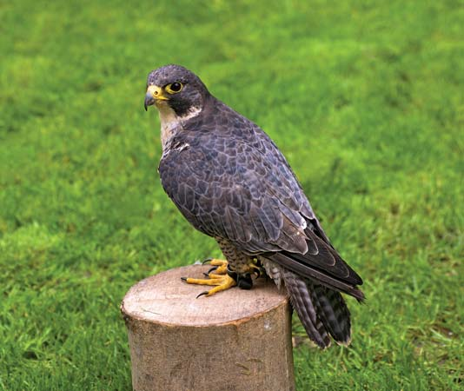
Fun Facts
Hunted by human
Known for their ruthlessness
Diving speeds up to 200mph
They are the fastest creatures on the planet

Slide 7

Bibliography
Britannica school
Planet minecraft
google
School building

Slide 8

About the Author
Favorite game minecraft
Favorite food cake
Has 1 brother
Is 9 years old
Favorite animal is pig

