Slide 1

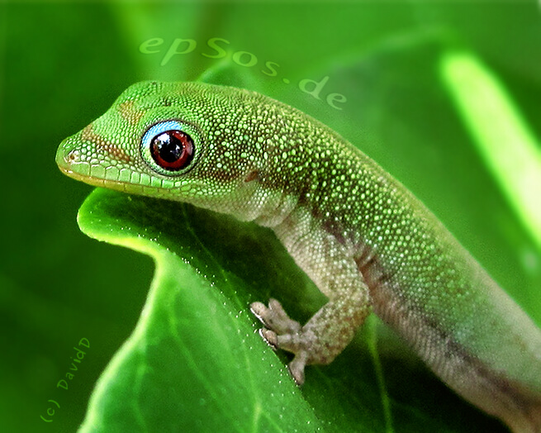
Geckos
By Adeline Russell

Slide 2
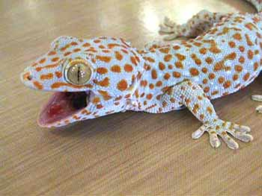
Introduction
I always thought that geckos were cool but I never new anything about them so I studied them to learn more I hope you learn alot about geckos enjoy!

Slide 3
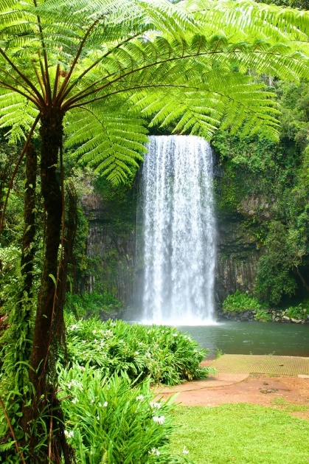

Habitat
Rocky deserts
Found in warmer parts
Mountainous regions
Rain forest
Grasslands
Jungles

Slide 4
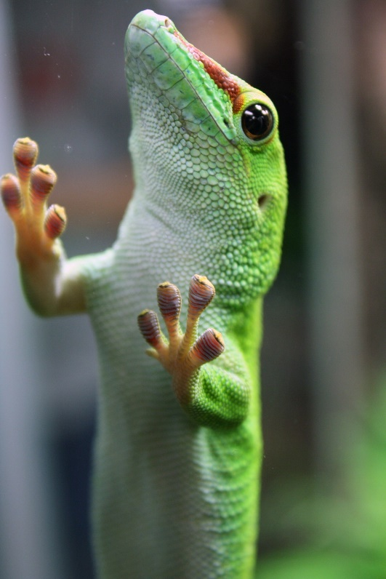
Characteristics
Small to medium species of lizard
Colors tan, black, brown, white, green, blue, orange, yellow
Weight is 18.g
Life span 2-9 years
Size-15-7 inches (40 cm) .01/
There little scales help them from the sun

Slide 5
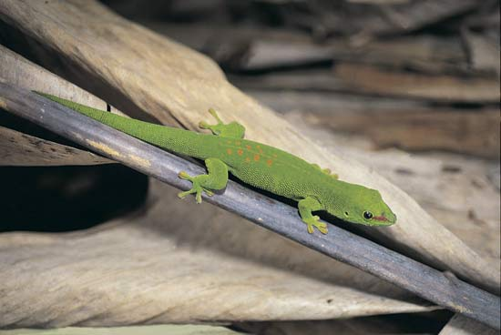
Food
Favorite food is insects
There diet is carnivores
They also like to eat mice worms and small birds
Moss
Plants
Some eat small reptiles

Slide 6
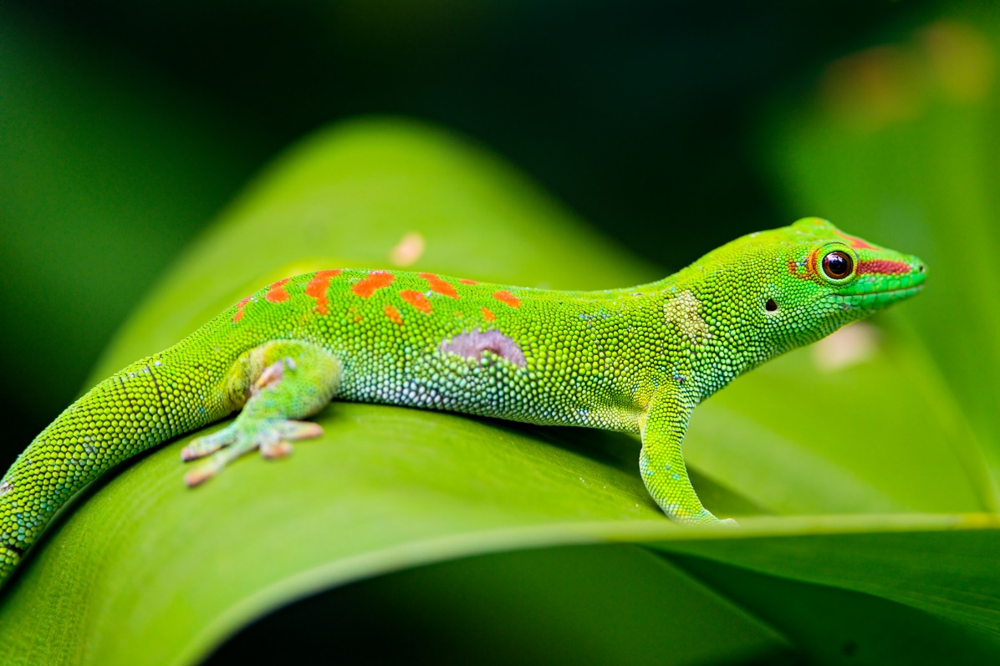
Fun Facts
There predators are snakes, birds, and, spiders
They can walk up vertical surfaces
Top speed 48.km
Female geckos can lay about two soft-shell eggs every six weeks
There is over 800 kinds of geckos
The gecko cleans its mouth after it eats
If a gecko loses its tail it comes back in a different color

Slide 7
Bibliography
A to z animals
Facts about geckos for kids
American museum of natural history
Cprofiri.com

Slide 8


About the author
She lives in Rhode island she has one dog and lives with her brother she is a great lacrosse player her favorite colors are red and blue she loves dolphins and turtles and dogs too.

