Slide 1
Gecko
By Josh Gibson

Slide 2
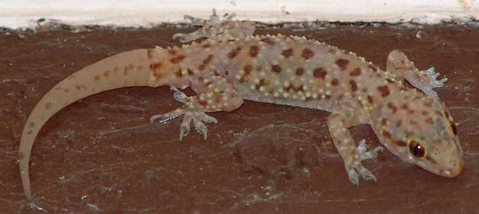
Habitat
More commonly found around the equator and in the Southern hemisphere
Geckos live in rainforests, deserts, grasslands, and marshes
Far from humans
Under stones.

Slide 3
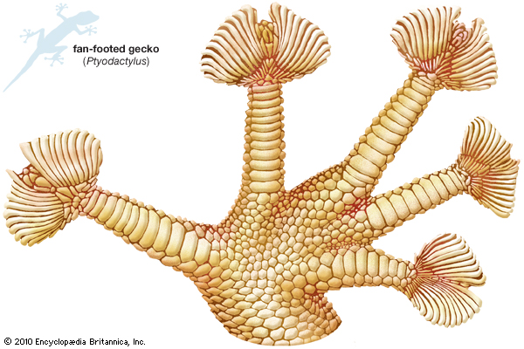
Physical Traits
Small to medium species of lizard
Many different colors (tan, black, brown, white, green, blue, orange, yellow)
Covered in scales
Life span: 2-9 years
Size: .04 – 15.7 inches

Slide 4
Food
Carnivores:
Insects
Mice
Worms
Small birds
Small reptiles
Moss, plants

Slide 5
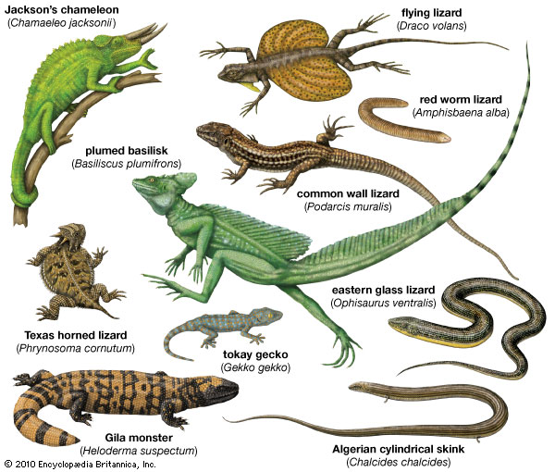
Interesting Facts
Geckos clean their eyes with their tongue.
Their amazing ability to walk up vertical surfaces as smooth as glass.
The feet of the gecko are covered in tiny hairs that stick to surfaces like sucker pads.
Geckos hatch from eggs.
Over 2000 species of geckos

Slide 6
Bibliography
A-Z Animals
Enchanted Learning\
Charline Profiri’s Geck Facts
Gecko Facs for Kids
Britannica
http://thumbs.dreamstime.com/z/blue-gecko-meditating-4136691.jpg

Slide 7
ABOUT THE ARTHOR
JOSHUA LIKES TO DO LOCROSS and karate

