Slide 1


GECKO
James DiGiacomo

Slide 2
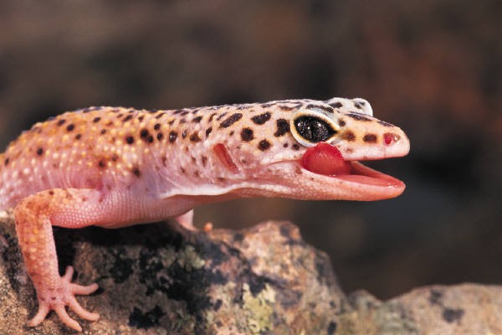
INTRODUCTION
At first I didn’t know any thing about geckos so I researched them. I worked hard and had a lot of fun!!!!! I hope you enjoy my power point!!!!!!!!!

Slide 3
HABITAT
Warm Climates
Rocky Deserts
Mountains
Houses
Rainforest
Jungles
Urban Areas
Northern Madagascar
Grasslands
Mediterranean Region
The Coast
Every Continents Except Antartica

Slide 4
CHARACTORISTICS
Colors are tan, black, white, green, blue, orange and yellow
Life span is 2-9 years
Feet have tiny hairs on them to help gecko climb flat surfaces
Scails protect gecko from sun
Use tails to balance and store water
size from a few cm. to 60 cm.

Slide 5
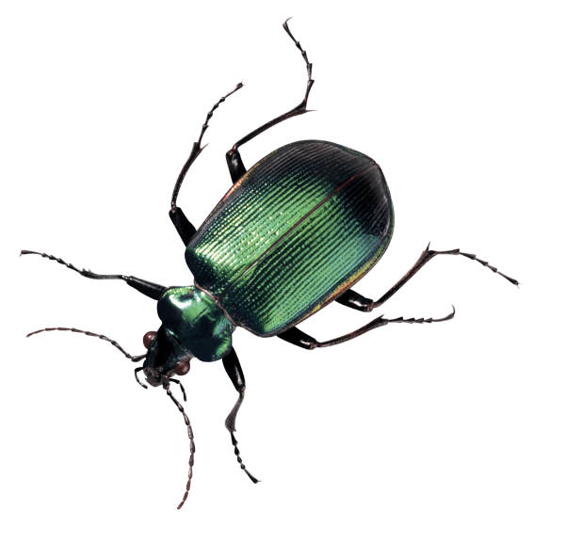
FOOD
Insects
Worms
Small birds
Mice
Moss
It Is A Carnivore
Prey To Snakes, Birds And Spiders

Slide 6
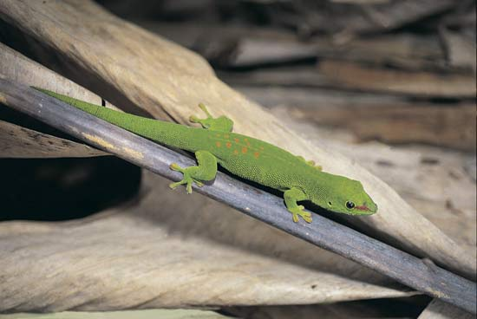
FUN FACTS
Mating Call Sounds Like Shortened Bird Call
Over 2.000 Species
Considered To Be Exstinct
Makes Clicking Noise That Sounds Like There Saying Gecko
Clean Eyes With Toungue
Good Luck In Hawaii
Scentific Name Is Gekkonidae
Female Lays 2 Sticky Eggs

Slide 7
BIBLIOGRAPHY
Britannica School
Facts About Geckos For Kids
Children’s Author Charline Profiri
A-Z animals
Google
Planet minecraft

Slide 8


ABOUT THE AUTHOR
Favorite game is minecraft
Plays baseball, tennis
Favorite food is cake
Favorite animal is the donkey
Has 2 sisters and 1 brothers
Likes to draw a lot
Is 9 years old

Slide 9
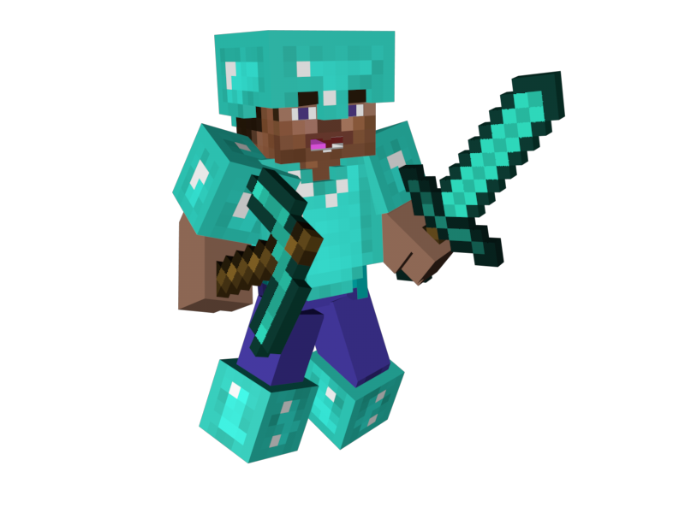
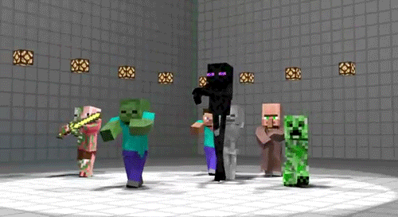
THE END
thanks forwatching!!!!!!

