Slide 1
Gecko
Mea maclure

Slide 2
Introduction
I chose the gecko because I did not know much about them and I wanted to know more. I did and I hope that you learn more about these awesome reptiles. Enjoy!

Slide 3
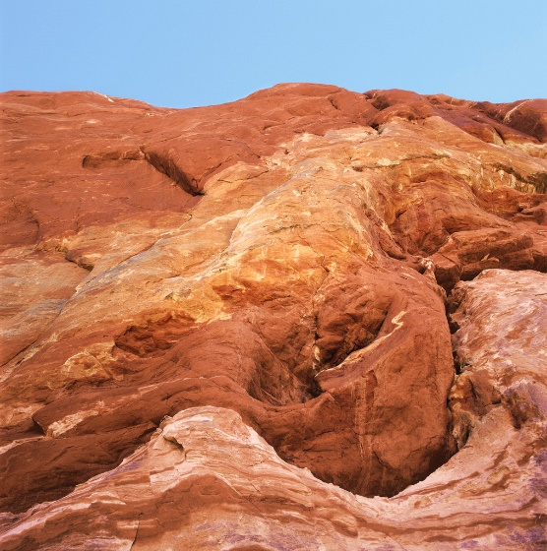
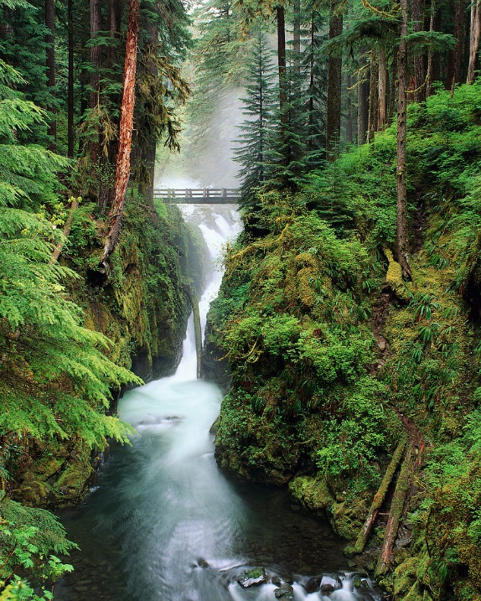
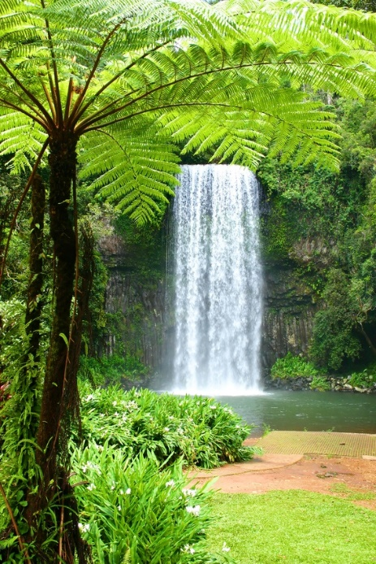
Habitat
Rocky lands
Cliffs
Rocky deserts
Mountains
Jungles
Rainforest
Urban areas
Warm climates around the world

Slide 4
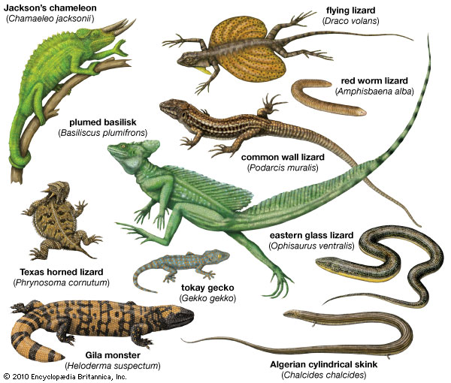
Characteristics
They can be ,Tan, Black Brown, White ,Green ,Orange and yellow
The gecko is a small to medium species of lizzard.
They can range in size from just 50 cm.
The life span is 2-9 years
They are reptiles
They are omnivors
They lay there eggs in leaves and bark

Slide 5
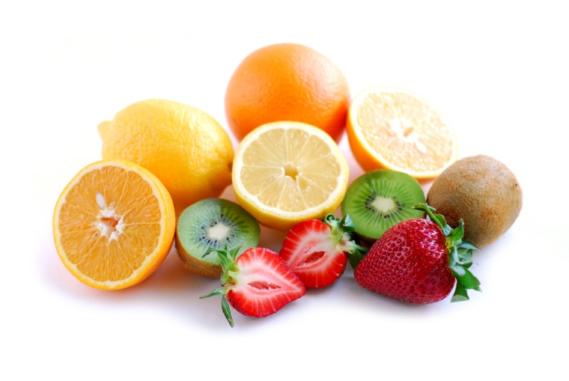
Food
Insects
Worms
Small mammals
Small birds
Fruits
Flower necter
Mosquitoes
plants

Slide 6
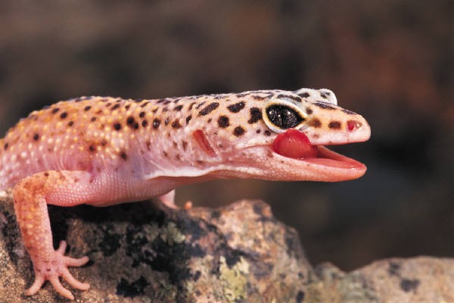
Fun Facts
Flaps of skin on each toe with tiny hairs
There are thought to be more then 2,000 different kinds of species
The largest speises of gecko is now belived to be extinct
There predators are –Large spiders,snakes and small birds

Slide 7
Bibliographey
Britanica
Charline Profiri
A-Z Animals
Facts about Geckos For kids

Slide 8

about the author
Mea loves to dance and she loves Disney. her favorite colors are turquoise and green. and loves nature and fashion. Also she loves rainbows all animals and music and dragons. She lives in Barrington R.I. with her dog and fish.

