Slide 1

Loggerhead
By: Aiden Pilipski

Slide 2
INTro
I picked the loggerhead because I knew nothing about them.

Slide 3
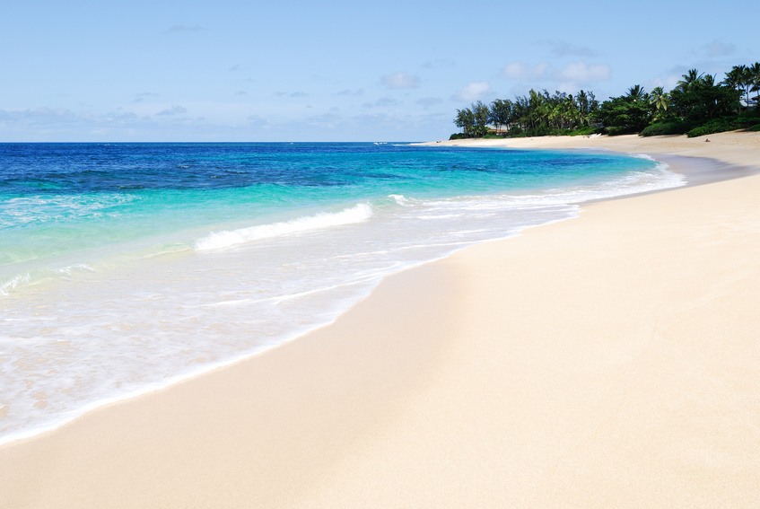
Habitat
Beaches
In water
Near shore costal
Temperate and tropical regions
Newfoundland to as far south as Argentina

Slide 4
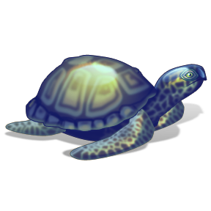
Characteristics
250 lbs
3 feet
Redish-brown
Slighty hart shaped
35 years old

Slide 5
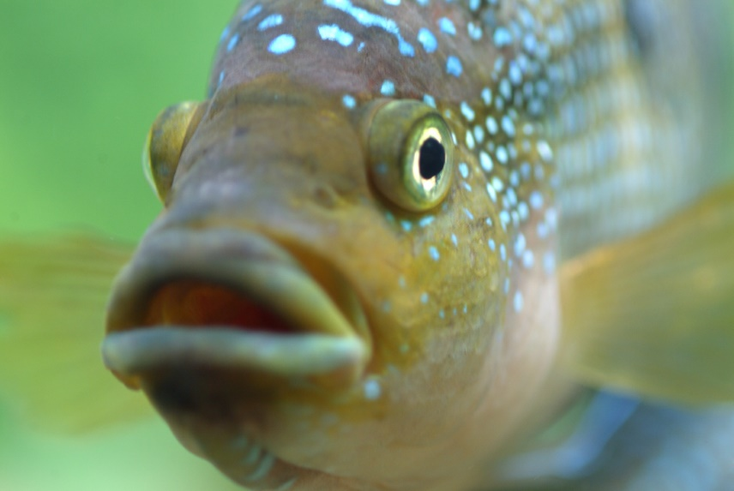
Food
Jellyfish
Conchs
Crabs
Fish
Seaweed
Sargassum
lobster

Slide 6
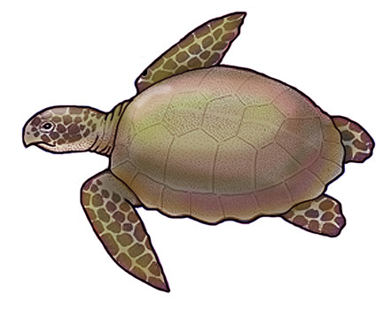
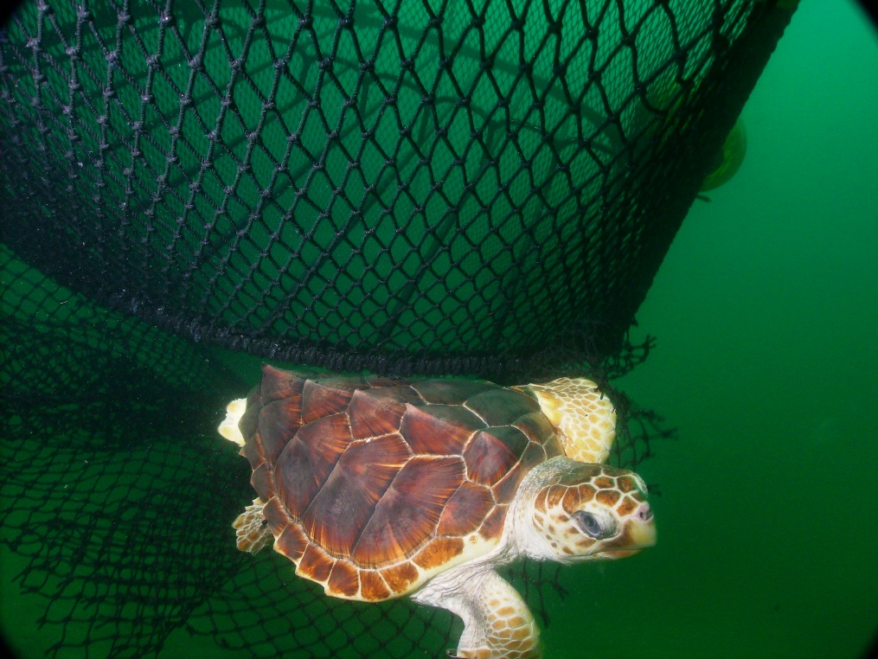
Fun Facts
Nest on ocean beaches
Swim away from land
Shallow continental shelf waters of U.S.
Biggest endangering is incidental capture
Live in three different places during their lives

Slide 7


Bibliography
NOAA Fisheries
National Geographic
Estystatic.com
I2clipart.com
Techcrunch
Audioholics.com
Gifiy.com

Slide 8



About me
My favorite food is pizza
I like to play video games
My best friends are Quincy and Konstantinos
I am in mrs. Butlers class

Slide 9
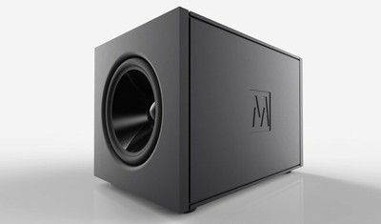
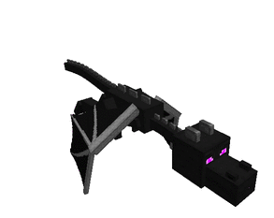

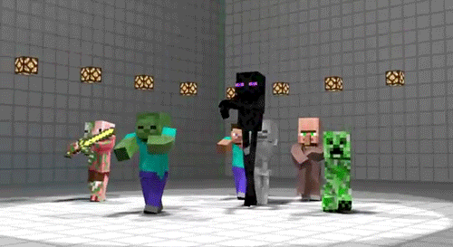


The end

