Slide 1
Owl
By Indigo

Slide 2

INTRODUCTION
At first I did not know much about owls now I no so much more. I hope you love my power point and lean about owls!!!

Slide 3
Habitat
They live everywhere but Antarctica
Rainforists
Grass lands
Desserts
greece

Slide 4
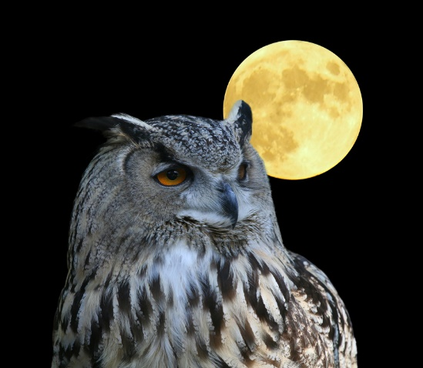
Characteristics
It has three eye lids
Severl owls have ‘ear’ tuffs on there heads
Unable to move eyes

Slide 5
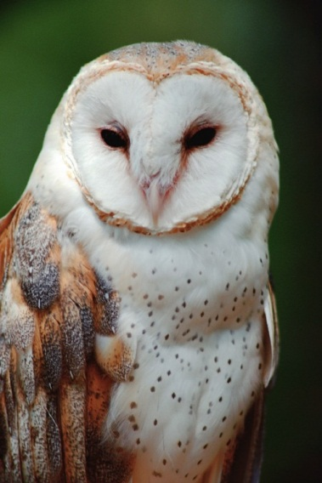
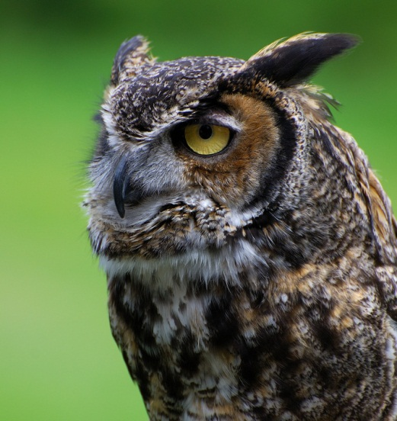
Food
Mice
Squirrels
Voles
Rabbits
Small birds
Insects
Reptiles
Spiders
Worms
fish

Slide 6

Fun facts
Around 205speices
Cannot chew there prey
Do not have teeth
Baby owls are called owlets

Slide 7
Bibliography
Britannica schools
Owl world/owl feeding
Miss o’kane

Slide 8

About the author
Indigo loves to read. Indigo is 9and she has 1 brother she loves school so much and loves gymnastics too .miss o’kane is one of my favorite teachers.

