Slide 2
OWL
By: Ruby Woodward

Slide 3
INTRODUCTION
I wanted to study owls because I love Harry Potter and there are a lot of owls in Harry Potter. Another reason is because I did not know a lot about owls, and I wanted to study an animal that I didn’t know about. I hope you learn a lot about owls!!!!!

Slide 4
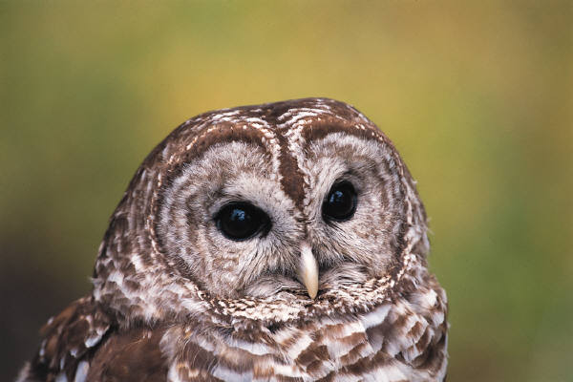
HABITAT
GROUP IS CALLED A PARLIAMENT
Desert
Shrubs + Bushes
Hollowed-out Log
Rainforests
Everywhere except Antarctica
Trees
Barns
Grasslands
OPEN PRAIRE

Slide 5
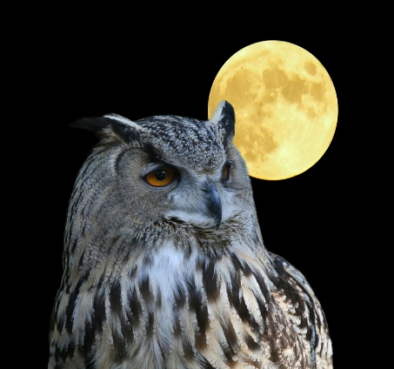
CHARACTERISTICS
Ears located on facial disc behind eyes and are hidden by feathers.
Some species have ear tufts on their heads, but they aren’t ears.
Ear tufts may indicate the owl’s mood, help camouflage it, or show aggression.
3 eyelids: one each for blinking, sleeping, and keeping the eye clean and healthy.
Feet with 2 toes pointing forward and backward.
Special feathers with fringes of softness to help muffle sound when flying.

Slide 6

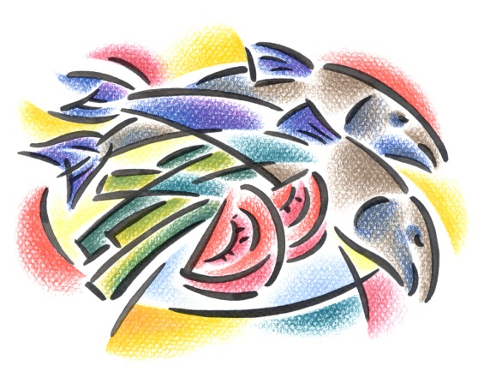
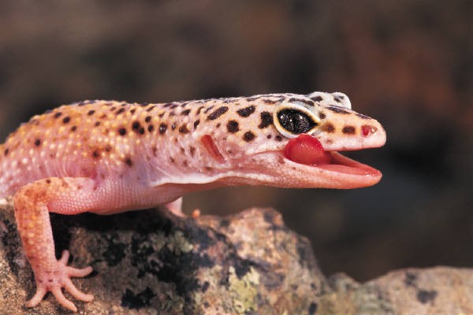
FOOD
Mice
Squirrels
Voles
Rabbits
Small Birds
Insects
Reptiles
Fish
Spiders
Snails
Crabs
Earthworms
Small Amphibians

Slide 7
FUN FACTS
About 205 Species
Unable To Move Their Eyes
In Cave Paintings 15,000 – 20,000 Years Old
Can Rotate Their Heads 270 Degrees
Cannot Turn Their Heads All The Way Around
Species Sorted Into Two Groups: Barn Owls And True Owls

Slide 8

Bibliography
Britannica School
Owl Habitat – Owl Facts and Information
Owl Feeding – Owl Facts and Information
20 Fun Facts About Owls – Owl Trivia
Facts About Owls
Miss. O’ Kane

Slide 9
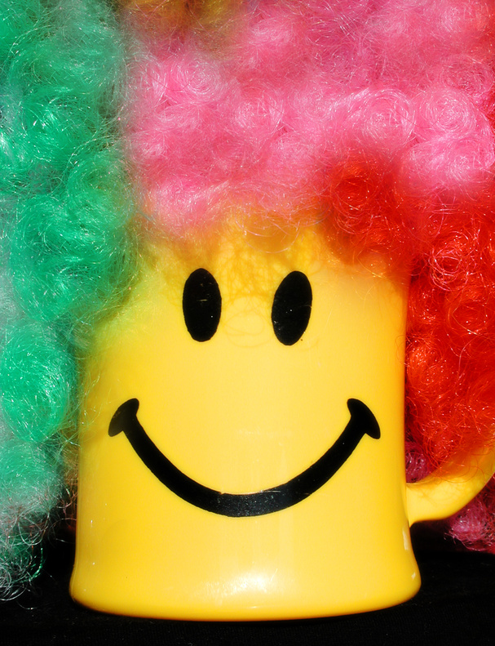

ABOUT THE AUTHOR
Ruby lives in Rhode Island with her sister and parents. Her favorite color is blue and her favorite food is Ice cream. She goes to Primrose Hill School in third grade.

