Slide 1
Sea Eagle
By Adriana O’Brien

Slide 2
introduction
At first I did not knew a lot about Sea Eagles so I want to learn more about them. And now I knew more about Sea Eagle.

Slide 3
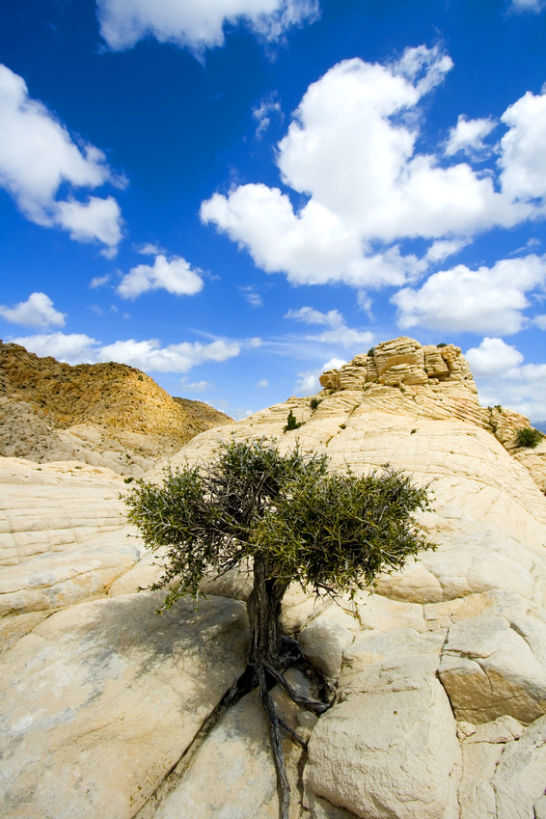

HABITAT
Sea Eagle go to high rocky cliffs along sea coast.
Sea Eagles live at islands , valleys , rivers , lakes.
Some Sea Eagles live in high trees.
Each Sea Eagles nests with in a couple of kilometeers.

Slide 4
Characteristics
The Sea Eagle is the largest eagle in the word!!
Sea Eagle wing span is up to 0.94 in length with a wing span or up to 2.45 m(8ft).
Sea Eagle have broad barn door wings a large head and a large thick beak.
Sea Eagle are about 9kg (20pounds).
The smaller males weigh are up to (11 to 13 pounds) (4.9-6kg).
The females weigh (15 to 20 pounds) (6.8-kg).

Slide 5
Food
Pray can often include fish, birds and mammals
Many Sea Eagles are scavengers. They take food from otters and sea birds.
Sea Eagles eat dead animals when they cannot find food.
Sea Eagle eat loons, grebes, ducks , coots, gulls ,geese.
Any food found near the surface

Slide 6
Fun Fact
The white tailed sea eagle was found nesting in 1912.
Their numbers are declining due to poaching and hunting.
They are sometimes called fish eagles.
These birds snatch fish from the water surface and even on top of rocks.

Slide 7
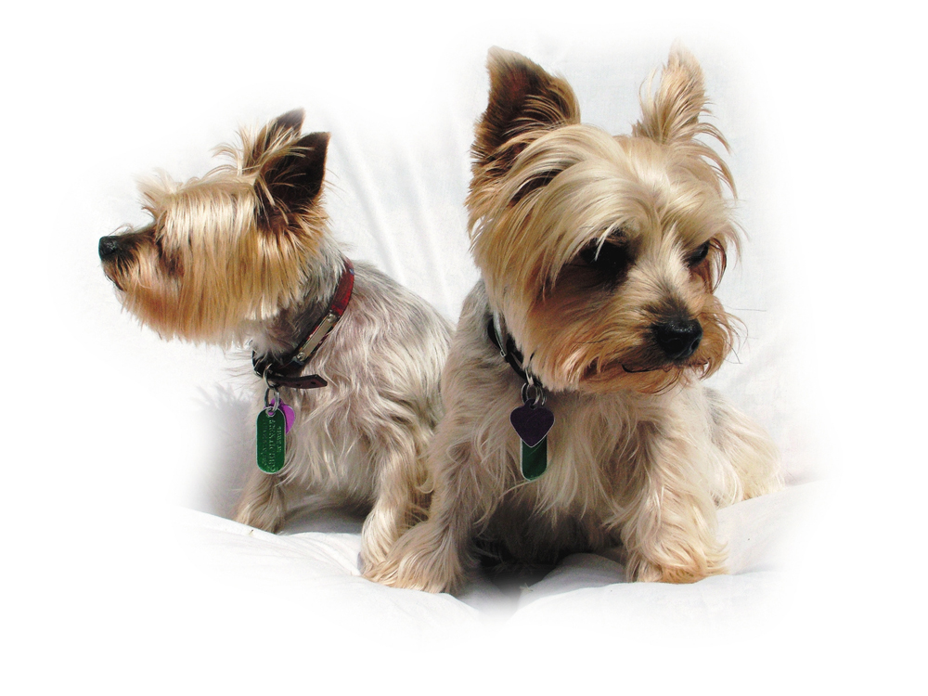
About The Author
My name is Adriana and I like dolphins. I love math, dogs, and softball. I like to go swimming and I love the ALP! For fourth grade I hope I get Mr. Farley.

Slide 8
Bibliography
Britannica
Safe search
A-Z animal

