Slide 1
Sea Eagle
By Megan Dupre

Slide 2
Introduction
At first I thought a sea eagle was a eagle that lived in the sea But when I studied it I found out that it actually lived along the sea coast and more places.I hope you like my power pont.

Slide 3
Characteristics
The White Tailed Sea Eagle is the forth largest eagle in the world
There wingspan up to 0.94 in length with a wingspan of up to 2.45meters (8 feet)
It has a large head and a large thick beak
The adult is mainly grayish brown except for the slightly paler head and neck, blackish flight feathers
The bare parts are yellow and the bill and legs

Slide 4
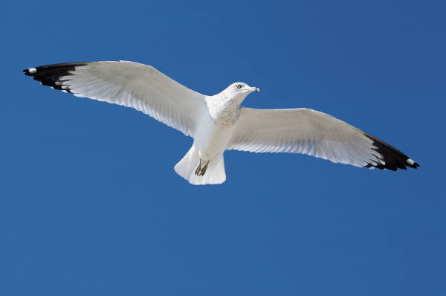
Food
Geese
Gulls
Salmon
Trout
Cod
Red fox
Muskrat
ducks

Slide 5

Fun Facts
Fourth largest eagle in the world .
There are less than 500 pairs of these huge birds in Australia.
Their numbers are declining due to poaching and hunting.
Sea eagles are sometimes called fish eagles.
They snatch fish from the water surface and even on rocks.

Slide 6
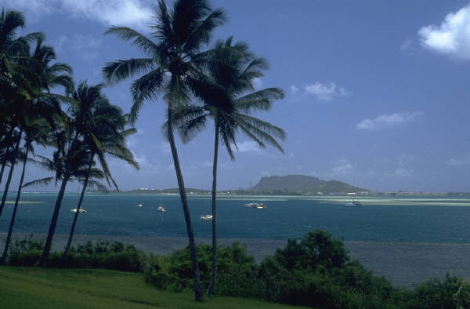
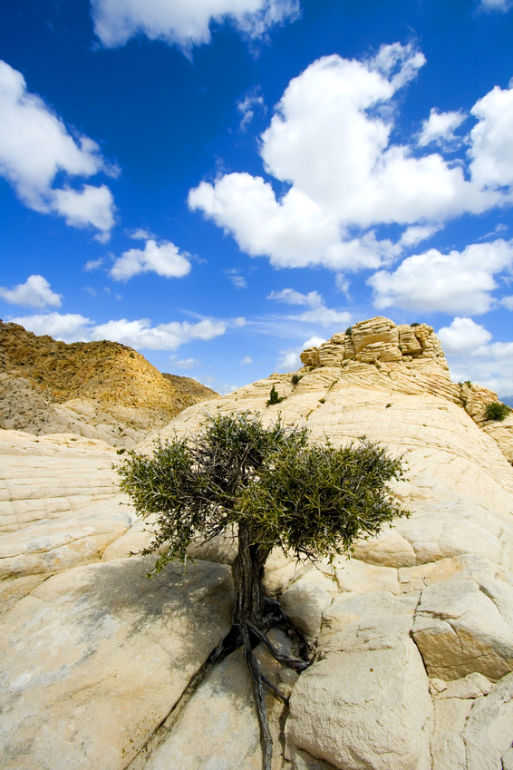
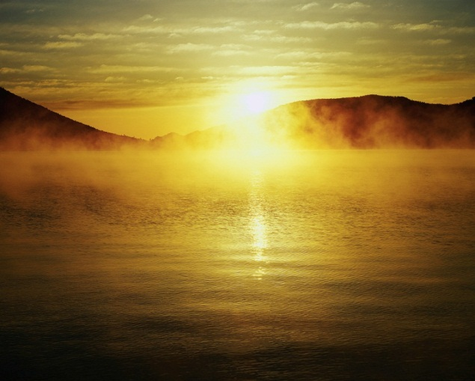
Habitat
Narrow coastal strips
Islands
Forest valleys
Near by lakes
High rocky cliffs
Along sea coasts

Slide 7
Bibliography
Safe search
Britannica

Slide 8
About the Author
Megan loves to play softball and she is 9 years old. She has one sister named Caitie who is 12 years old. Her favorite food is tacos. She has been dancing for 6 years taking ballet, tap, jazz, modern, and hip hop. Her favorite one is jazz. She has a dog named Sassy who was abandoned in Texas and adopted by the Dupre family.

