Slide 1
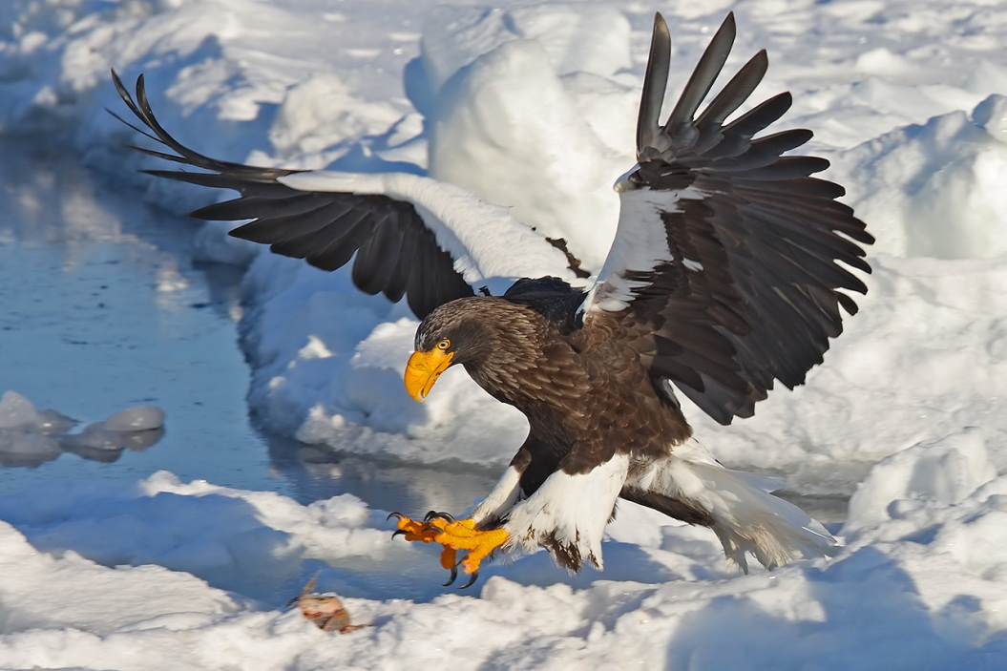
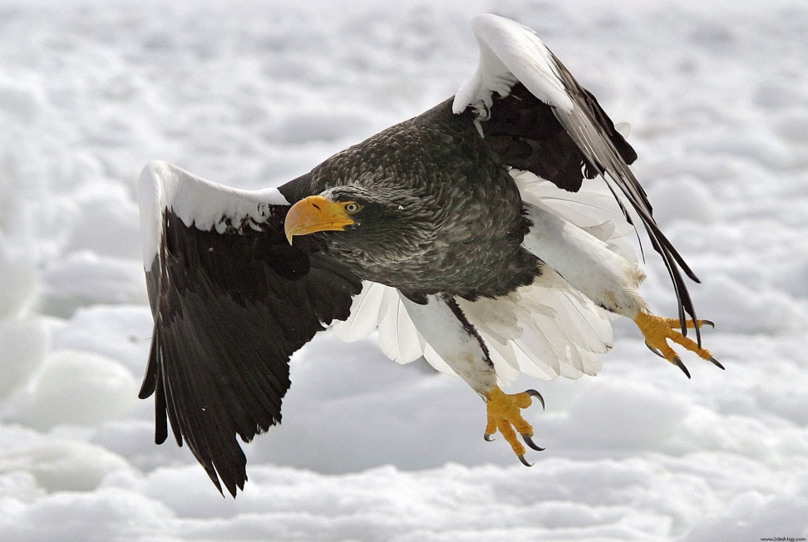
Sea Eagles
By: Tucker Squires

Slide 2

Introduction
I chose the Sea Eagle because I have never heard of it. It sounded very interesting because I have studied eagles in the past but none of them sounded so interesting. I hope you learn a lot about Sea Eagles!

Slide 3
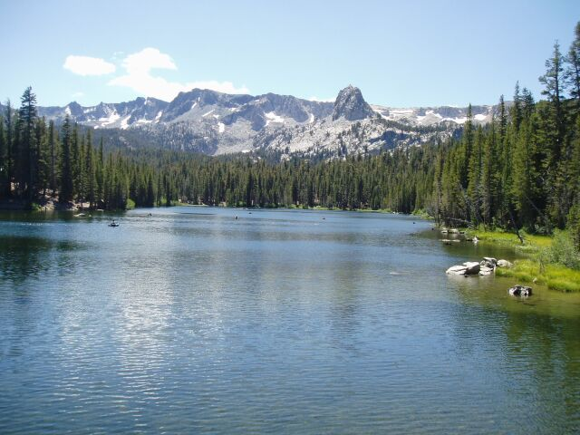

Habitat
Lives in Greece
Along rivers, big lakes and tidewaters
Normally live in sheltered areas
Nests in trees near water
Live mostly in Europe and Asia
Coast and sea
North central Europe

Slide 4
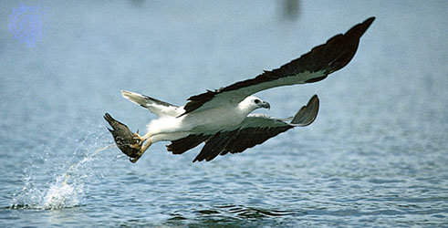
Characteristics
Large head
Large thick beak
Grayish brown
Boney parts are yellow
Wingspan up to 8 ft.[2.45 m.]
Distinctive white tail
Approximately 17 pounds

Slide 5
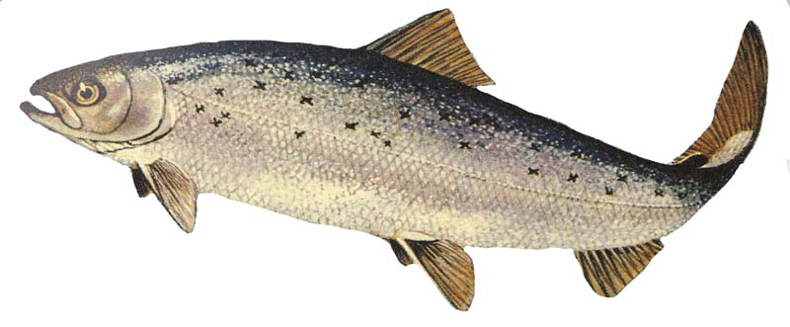
Food
Like and rely on salmon
Large on eating fish
Steal fish from other birds
Other birds and small mammals
Target water based birds
Dive to catch fish
Consume 500 to 600 grams
Loons, grebes, ducks, coots, auks, gulls, geese, swans, cormorants, ospreys

Slide 6
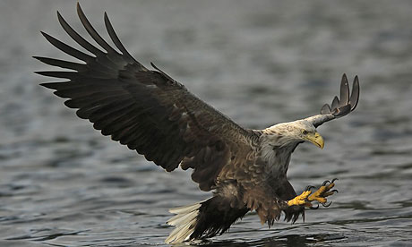
Fun Facts
Fourth largest eagle in the world
Found to live on an average of 21 years
Eggs laid in March and April
Mature at 4 to 5 years of age
Very powerful hunters

Slide 7

Bibliography
World Book Kids
Seafari
National Geographic
Tctechcrunch
Imgur
scratch.mit.edu
Britannica school
Californiafishingonline.com
Fda.com
Hdwallpapers.in
Dchome.net

Slide 8
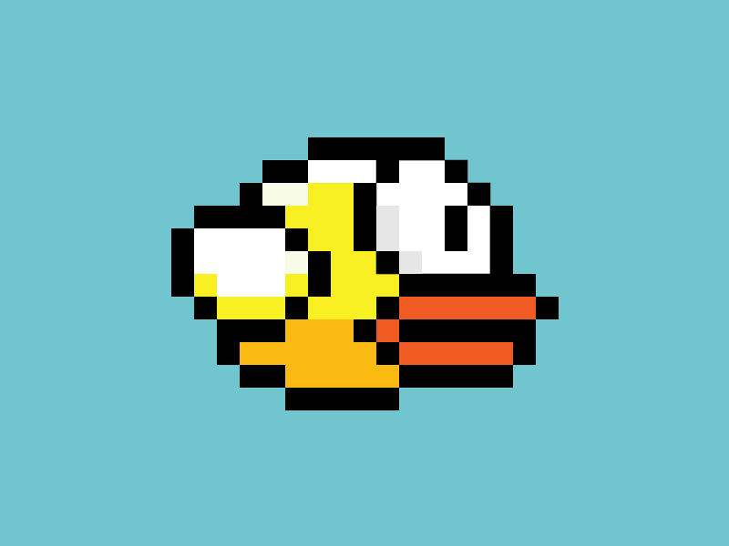
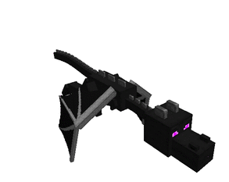
ABOUT THE AUTHOR
Tucker Squires is a great hockey player! Tucker lives in Rhode Island with his brother, Chase and his parents. His favorite animal is the elephant and his favorite color is red. He loves playing sports with all of his friends! Tucker likes Minecraft and Flappy bird.

