Slide 1
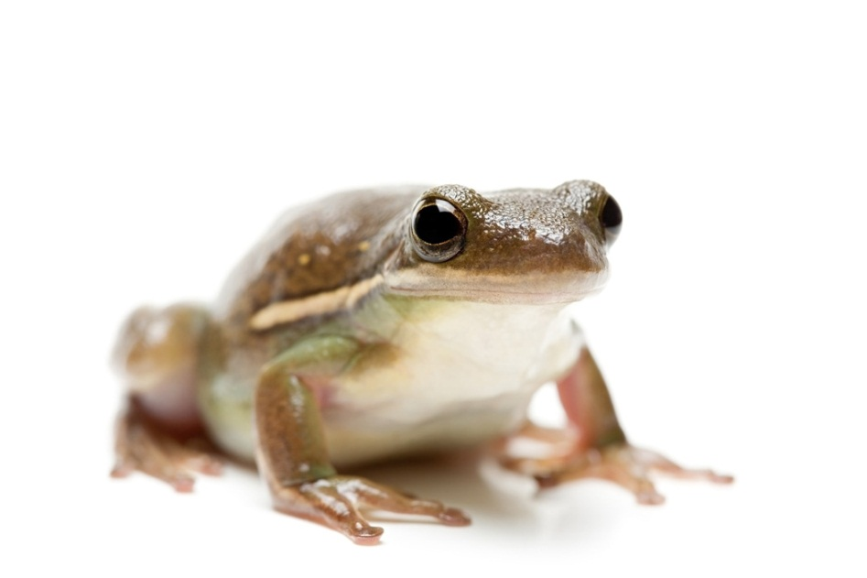

Tree Frogs
By Taylor Phillips

Slide 2
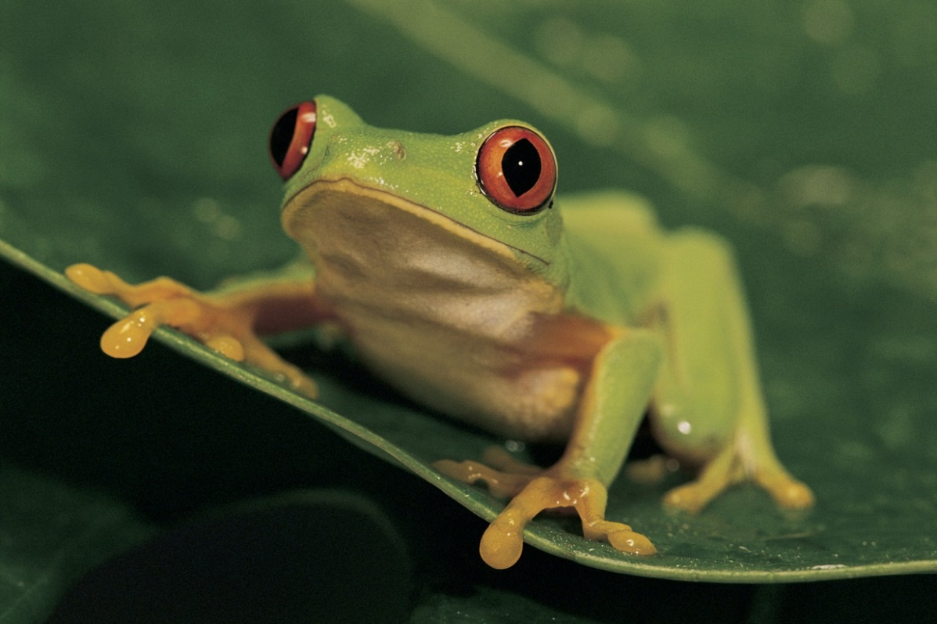
INTRODUCTION
I chose the Tree frog because it sounded very interesting to me. I know a lot of things about frogs .But not about Tree frogs so I decided to study tree frogs and I learned a lot of cool facts about tree frogs. I hope you learn a lot of interesting things about tree frogs
Enjoy

Slide 3
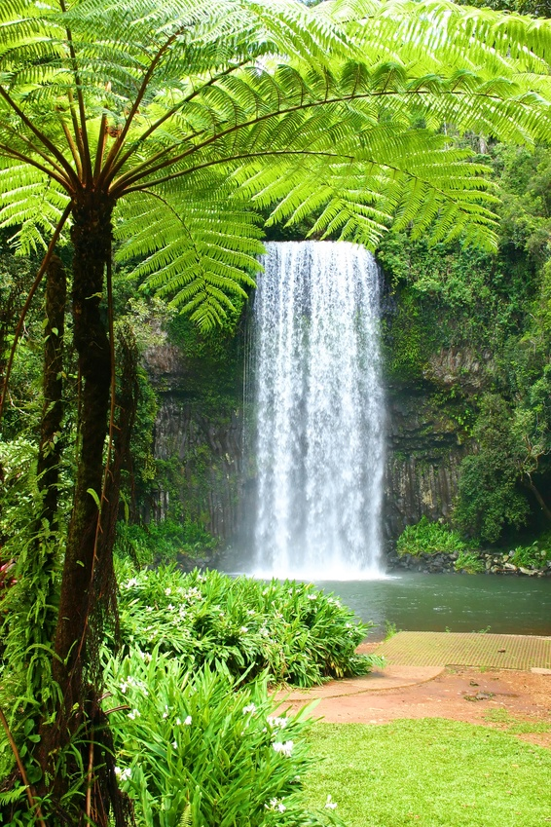
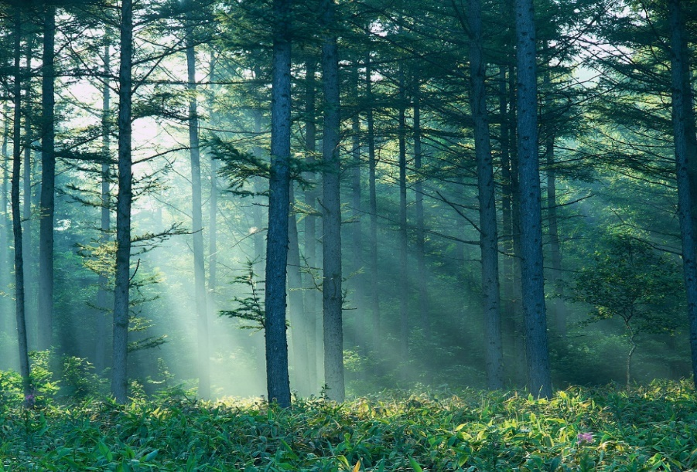
Habitat
Lives in Greece
Rain Forest
Marshes
Woodlands
Also in shublands
Found in dry areas
Asia to japan
Northwest Africa
Vinards, lake shores, stream banks
orchids

Slide 4
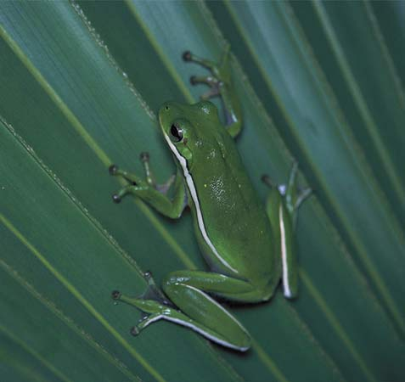
Characteristics
Small species
Black, green, grey, brown, yellow
Hibernate in walls, cellars, leaf piles and under rocks
The Cuban tree frogs is the largest tree frog
Long narrow bodies
There rounded toes gives there feet more suction

Slide 5
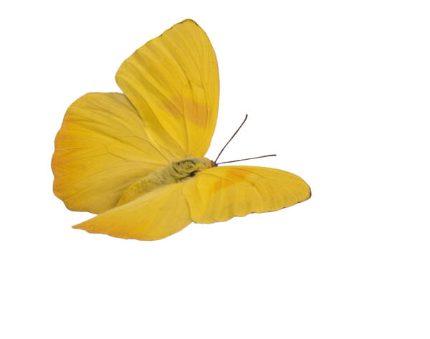
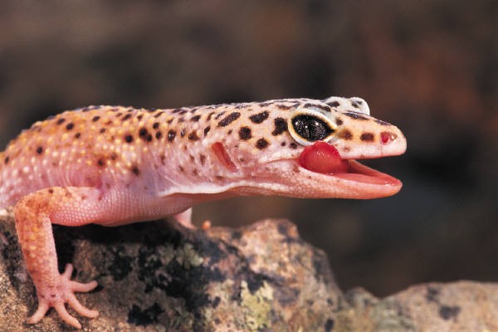
Food
They are carvonores
Eat anything that will fit in its mouth
Favorite food is insects
Flies, butterflies, ants, crickets
Beetles, moths, caterpillars
Small mammals, other frogs lizards snakes and worms

Slide 6
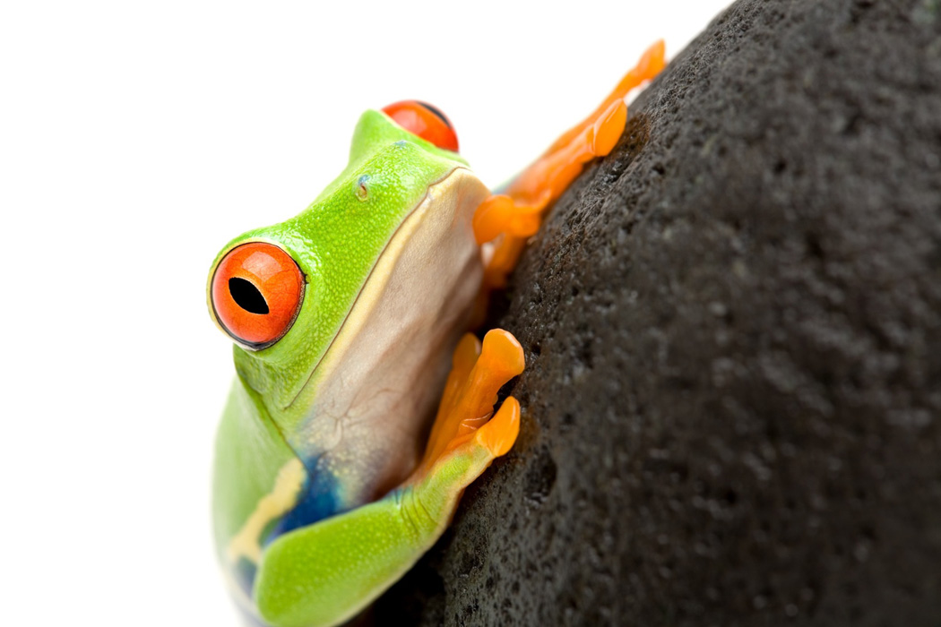
FUN FACTS
Males have golden brown throats
Females have white throats
Birds mammals and reptiles prey
30 species' live in the USA
Over 600 live in south and central and America
Often kept in captivity for 15 years
Birds and fish eat Tree Frogs

Slide 7

Bibliography
A-Z Animals
National Wildlife Federation
All About Frogs
Nature Photography
FrogDaze
Diet.yukozimo.com/what-do-tree-frogs-eat

Slide 8
About the author
Taylor Phillips is a great lacrosse player. Taylor lives in Rhode Island with her sister Madison. Her favorite color is blue and she loves playing soccer too. Her favorite animal is a sea turtle. She has one dog. Taylor is very funny. Her favorite food is ice cream taylor’s favorite ice cream flavor is cotton candy. And Taylor also loves playing with her friends.

