Slide 1

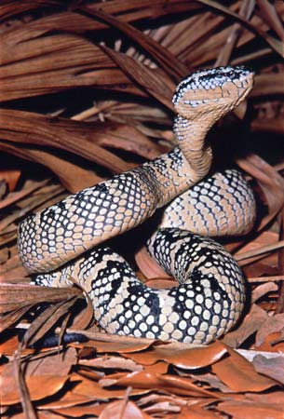
viper
By: Quincy

Slide 2
intro
I picked viper because I wanted to learn about snakes and I found an opportunity to learn about them. I did not know that it was the biggest group in the whole thing.

Slide 3
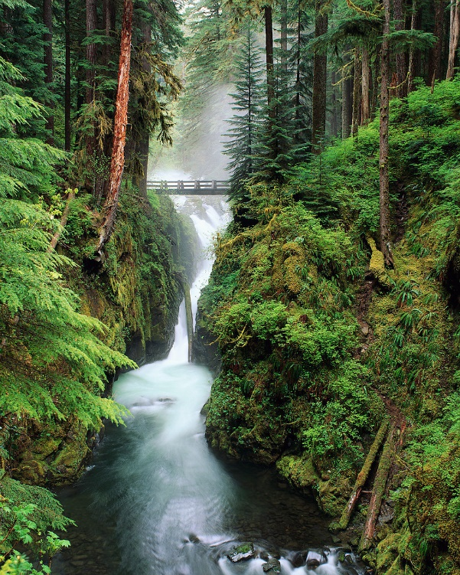
Habitat
Two viper Habitats
Mountains
Bushes
Woodlands
Rain forests
Deserts
Caves
Swamps

Slide 4
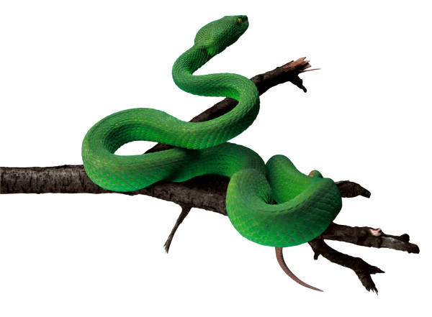
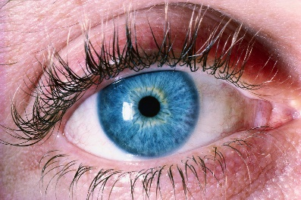
Physical traits
Red or brown eyes
Yellow or green skin
65 cm. long
Cold blooded
Have beady eyes

Slide 5
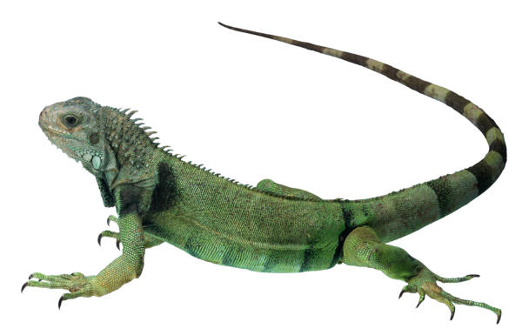

Food/Diet
Lizards
Birds
Amphibians
Rodents
Can last a year without food
$$5$$

Slide 6

Interesting facts
They are endangered because people want their soft skin
A viper’s bite is so powerful you need instant medication
A female can have 20 babies
Their venom carries more than 12 different toxins
Their scientific name is viperdae

Slide 7


Bibliography
Britanica school
Junglewalk.com
Imgur.com
tctechcrunch.com
Glickr.com
picgift,.com

Slide 8

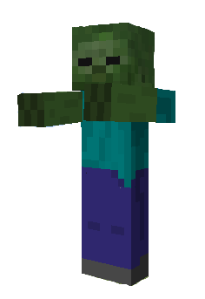
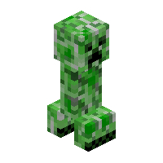

About the author
I am nine years old
I like to play video games
My favorite food is mac and cheese with hot dogs
I love to draw pictures
My best friends are K.M, Aiden, Kyler, James, Tucker, Finn.
I play Minecraft and Smash Flappy

Slide 9





The
End

